Slide 1
Applied SAS Industry Training

Slide 2
CHAPTER 1: Biggest myths
Myth 1: Programming is difficult because it takes an advanced way of thinking to accomplish.
  Truth: People struggle because they don’t realize how “dumb” a computer is. Simply dumbing yourself down goes a long way to being a great programmer.

Slide 3
CHAPTER 2: Intro to SAS
A SAS program is a series of steps.
Each step takes your data from one form to another until you can use the data for analysis.

Slide 4
CHAPTER 2: Intro to SAS
95% of all SAS is broken down into 2 types of steps:
  DATA steps
  PROC steps

Slide 5
CHAPTER 2: Intro to SAS
DATA steps allow you to:
  Change variables from one form to another
    Numeric to character and vice versa
  Merge and combine data sets
  Create new variables either on their own or from mathematical functions of other variables:
    Profit (the new variable) = total_revenue – total_cost
  And Many more….

Slide 6
CHAPTER 2: Intro to SAS
PROC steps allow you to:
  Use SQL methods to:
    Merge, sum, take averages, count, etc… from data
  Perform Statistical analysis
  Create graphs and other visual displays
  Etc…

Slide 7
CHAPTER 2: Intro to SAS
So what’s the difference then????
  Little, SAS is a very flexible language which means there are countless ways to do something.
  Both DATA steps and PROC steps will get you from A to B when it comes to data manipulation but all analysis and graphs are done with PROC steps.
  Yet, DATA steps are unique for also allowing you to make a dataset from either raw data or from scratch.

Slide 8
CHAPTER 3: Making a Data Set
A dataset is just like a spreadsheet. You fill it with information and then perform operations on it.

Slide 9
CHAPTER 3: Making a Data Set
So how do you make one?
Use a Data Step!
Of Course, this dataset is empty. We need to fill it with something between the ‘data’ statement and the ‘run’ statement.
data profit; /*creates a data set named ‘profit’ */
run; /* tells SAS to finish creating the dataset */

Slide 10
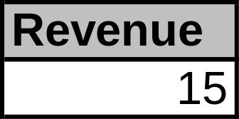
CHAPTER 3: Making a Data Set
Lets add some info to dataset ‘profit’.
Add a variable called ‘revenue’ and set it equal to 15.
data profit; /*creates a data set named ‘profit’ */
revenue=15; /*creates a variable named ‘revenue’ and assigns a value to it */
output; /* Tells SAS to output the previous variable into the dataset */
run; /* tells SAS to finish creating the dataset */
Output ==>

Slide 11
CHAPTER 3: Making a Data Set
The previous output might have looked similar to Excel, and that’s because it is!
  End results are the same
To make sure the intuitive understanding is there lets look at how you would get the same results from Excel and from using the Data Step in SAS.

Slide 12
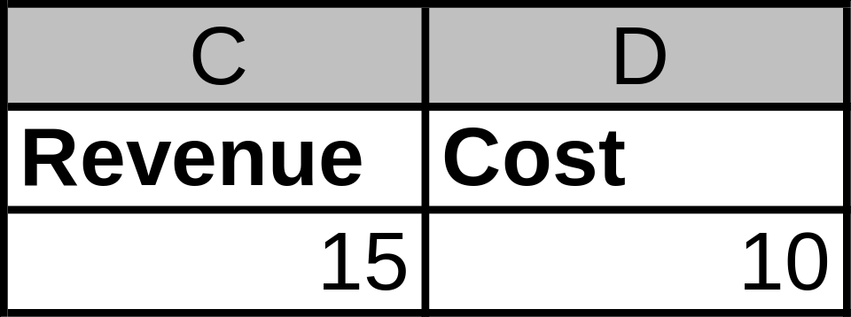
CHAPTER 3: Making a Data Set
In Excel you might want to calculate profit. So first you add the variables Revenue and Cost to the Excel sheet as seen below.

Slide 13
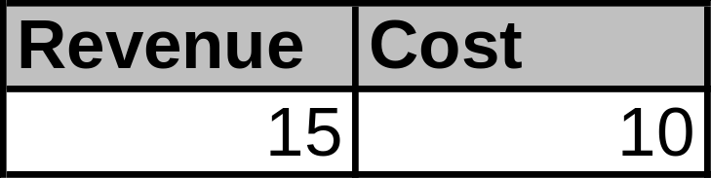
CHAPTER 3: Making a Data Set
In SAS you will use the DATA step to create a dataset named “Profit” with the same two variables: Revenue, and Cost. And you say what values Revenue and Cost will be just like Excel.
data profit; /*creates a data set named profit */
Revenue=15; /*creates a variable named Revenue and sets it equal to 15*/
Cost=10; /*creates a variable named Cost and sets it equal to 10 */
output; /* Tells SAS to output the previous variables into the dataset */
run; /* tells SAS to finish creating the dataset */
Output ==>

Slide 14
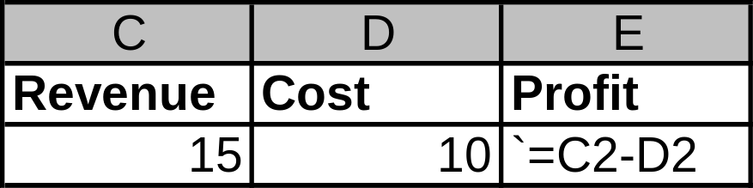
CHAPTER 3: Making a Data Set
Now that we have Revenue and Cost it’s time to calculate Profit. In Excel it looks:

Slide 15
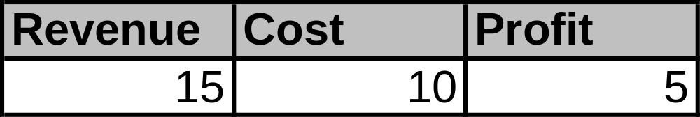
CHAPTER 3: Making a Data Set
Likewise in SAS:
data profit; /*creates a data set named profit */
Revenue=15; /*creates a variable named Revenue and sets it equal to 15*/
Cost=10; /*creates a variable named Cost and sets it equal to 10 */
Profit=Revenue – Cost;
output; /* Tells SAS to output the previous variables into the dataset */
run; /* tells SAS to finish creating the dataset */
Output ==>

Slide 16
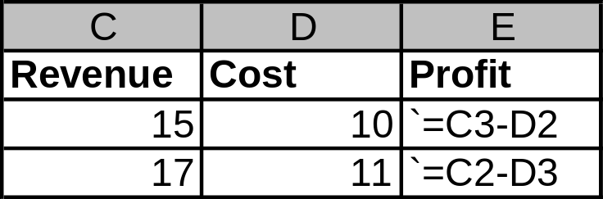
CHAPTER 3: Making a Data Set
Now it’s time to add a second row. In Excel it’s just typing in another row under the previous.

Slide 17
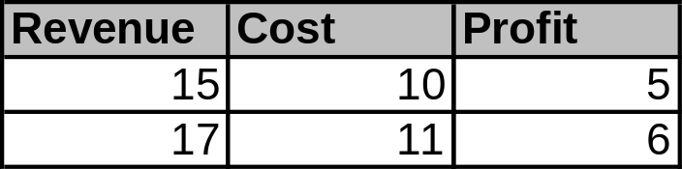
CHAPTER 3: Making a Data Set
In SAS, we need to dumb things down and tell the program to add to the next line using an additional ‘output’ statement after adding the next row of values.
data profit; /*creates a data set named profit */
Revenue=15; /*creates a variable named Revenue and sets it equal to 15*/
Cost=10; /*creates a variable named Cost and sets it equal to 10 */
Profit=Revenue – Cost;
output; /* Tells SAS to output the previous statements to a dataset */
Revenue=17;
Cost=11;
Profit=Revenue-Cost;
output; /* Tells SAS to output the statements since last ‘output’ to next row */
run;
Output ==>

Slide 18
CHAPTER 3: Try on your own
Create a dataset called: Loans
Make 3 rows of the following info respectably:
  Customer: David, Ashley, Mike
  Product: HEIL, MTG, LOT
  LoanAmt: 50000, 100000, 90000
  Appraisal: 65000, 112000, 75000
  LTV (Loan to Value) for each
  Hint1: Use “/” for division: LTV = Loan/Appraisal
  Hint2: Use “ ” for entering character values: Customer=“Mike”
  Hint3: Do NOT use commas or any character other than numeric when entering numbers.

Slide 19
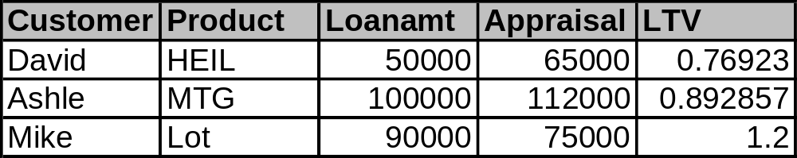
CHAPTER 3: Try on your own
(Result)
Output ==>
Everything looks good, except poor Ashley is now just an Ashle
One vital part of creating variables is left:
The "Format" statement!

Slide 20
CHAPTER 4: Variable manipulation
There are many ways to manipulate the way variables, and data in general appear and behave.
Lets look at how to use the ‘Format’ statement with the ‘Try on your own’ exercise.

Slide 21
CHAPTER 4: Variable manipulation
Try yourself Solution
data Loans;
Customer="David";
Product="HEIL";
Loanamt=50000;
Appraisal=65000;
LTV=loanamt/appraisal;
output;
Customer="Ashley";
Product="MTG";
Loanamt=100000;
Appraisal=112000;
LTV=loanamt/appraisal;
output;
Customer="Mike";
Product="Lot";
Loanamt=90000;
Appraisal=75000;
LTV=loanamt/appraisal;
output;
run;
Now what we should have done is to tell the program more about the Variables before we stuck values in them. We use a ‘Format’ statement for that and stick it above the variables.
format Customer $7.
Product $5.
Loanamt dollar12.0
Appraisal dollar12.0
LTV percent8.1;

Slide 22
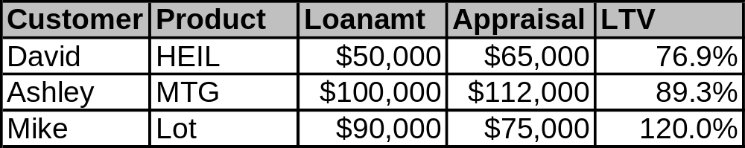
CHAPTER 4: Variable manipulation
data Loans;
format Customer $7.
Product $5.
Loanamt dollar12.0
Appraisal dollar12.0
LTV percent8.1;
Customer="David";
Product="HEIL";
Loanamt=50000;
Appraisal=65000;
LTV=loanamt/appraisal;
output;
Customer="Ashley";
Product="MTG";
Loanamt=100000;
Appraisal=112000;
LTV=loanamt/appraisal;
output;
Customer="Mike";
Product="Lot";
Loanamt=90000;
Appraisal=75000;
LTV=loanamt/appraisal;
output;
run;
‘$7.’
after Customer says the value can be up to 7 characters long, plenty for poor Ashley.
‘$5.’
after product means the value can be up to 5 characters long.
‘dollar12.0’
after Loanamt and Appraisal says values should look like currency with a dollar sign and can be 12 characters long (including dollar sign and commas and decimal point) and 0 characters after the decimal point.
‘percent8.1’
after LTV says values should be in percents, at most 8 characters long (including decimal point and percent (%) sign with only one character after the decimal point.
Output

Slide 23
CHAPTER 4: Variable manipulation
DAY 2

Slide 24
CHAPTER 4: Variable manipulation
Now let’s recap from yesterday.
  Data step statement names the data set
    Data profit;
  Format statement names variables and tells what kind they are (currency, percent, character)
    Format revenue dollar10.0
    cost dollar10.0;
  Variable statements tells what values go into the variables
    revenue=15;
    cost=10;
  Output statement tells SAS to output the previous variables into a row
    output;
  Run statement tells SAS to finish completing the dataset

Slide 25
CHAPTER 4: Variable manipulation
Looks much more precise in practice
data profit;
format revenue dollar10.0
cost dollar10.0;
Revenue=15;
Cost=10;
output;
run;

Slide 26
CHAPTER 4: Variable manipulation
Common Formats
  $w. Standard character Variable up to ‘w’ spaces long
  w.d Standard number Variable up to ‘w’ spaces long and ‘d’ after the decimal point (notice NO ‘$’ sign
  percentw.d Percent variable up to ‘w’ long and ‘d’ after the decimal point
  dollarw.d Currency variable up to ‘w’ long and ‘d’ after the decimal point
  commaw.d Number variable with commas and decimal points
  datew. writes as dates (date7. => 01JUL11, date9. =>01JUL2011)
Format link http://www.sfu.ca/sasdoc/sashtml/lgref/z1263753.htm

Slide 27
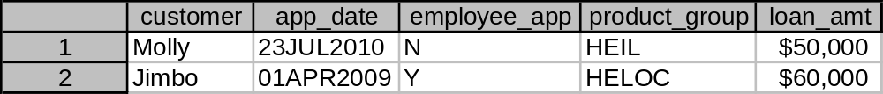
CHAPTER 4: Try on your own 1
Create a dataset named loan_info_1
Create two rows with the following information respectably (format first)
  Customer: Molly, Jimbo
  App_date: 23JUL2010, 01APR2009
  Employee_app: N, Y
  Product_group: HEIL, HELOC
  Loan_amt: 50000, 60000
Hint!: App_date is not Character but it’s also not a regular numeric variable.
  In format statement use ‘date9.’ because 23JUL2010 has 9 digs
  Use “ “ but add a ‘d’ for date➔ “23JUL2010”d
Output ==>

Slide 28
CHAPTER 4: Try on your own 1
(Solution)
data loan_info_1;
format customer $6.
app_date date9.
employee_app $2.
product_group $6.
loan_amt dollar10.;
customer="Molly";
app_date="23JUL2010"d;
employee_app="N";
product_group="HEIL";
loan_amt=50000;
output;
customer="Jimbo";
app_date="01APR2009"d;
employee_app="Y";
product_group="HELOC";
loan_amt=60000;
output;
run;

Slide 29
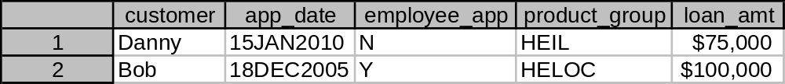
CHAPTER 4: Try on your own 2
Create a dataset named loan_info_2
Create two rows with the following information respectably (remember, format the variables first)
  Customer: Danny, Bob
  App_date: 15JAN2010, 18DEC2005
  Employee_app: N, Y
  Product_group: HEIL, HELOC
  Loan_amt: 75000, 100000
Hint!: App_date is not Character but it’s also not a regular numeric variable.
  In format statement use ‘date9.’ because 15JAN2010 has 9 digs
  Use “ “ but add a ‘d’ for date➔ “15JAN2010”d
Output ==>

Slide 30
CHAPTER 4: Try on your own 2
(Solution)
data loan_info_2;
format customer $6.
app_date date9.
employee_app $2.
product_group $6.
loan_amt dollar10.;
customer=“Danny";
app_date=“15JAN2010"d;
employee_app="N";
product_group="HEIL";
loan_amt=75000;
output;
customer=“Bob";
app_date=“18DEC2005"d;
employee_app="Y";
product_group="HELOC";
loan_amt=100000;
output;
run;

Slide 31
CHAPTER 5: Dataset manipulation
Creating datasets is REAL fun but usually you’re already stuck with the data someone else (possibly you) has created.
Now we’ll put the information from both of the previous data sets (loan_info_1, loan_info_2) together.

Slide 32
CHAPTER 5: Dataset manipulation
We could create one big data set like this:
But it would be a waste since we already have the information in already made datasets.
data loan_info;
format customer $6.
app_date date9.
employee_app $2.
product_group $6.
loan_amt dollar10.;
customer="Molly";
app_date="23JUL2010"d;
employee_app="N";
product_group="HEIL";
loan_amt=50000;
output;
customer="Jimbo";
app_date="01APR2009"d;
employee_app="Y";
product_group="HELOC";
loan_amt=60000;
output;
customer=“Danny";
app_date=“15JAN2010"d;
employee_app="N";
product_group="HEIL";
loan_amt=75000;
output;
customer=“Bob";
app_date=“18DEC2005"d;
employee_app="Y";
product_group="HELOC";
loan_amt=100000;
output;
run;

Slide 33
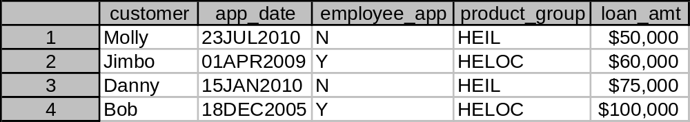
CHAPTER 5: Dataset manipulation
Rather we’ll use the ‘Set’ statement to do it for us.
data loan_info_combine;
set loan_info_1
loan_info_2;
run;
OUTPUT ==>

Slide 34
CHAPTER 5: Dataset manipulation
Day 3

Slide 35
CHAPTER 5: Dataset manipulation
Now we have a Data Set put together.
Let’s add some delinquency information.

Slide 36
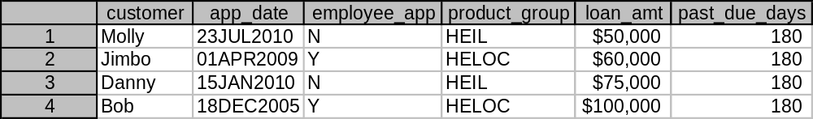
CHAPTER 5: Data set manipulation
We’ll create a dataset named ‘loan_dq’ by using our loan_info_combine dataset and add Delinquency information to it.
First make sure you format your new variable ‘past_due_days’.
Of course not everyone is past due 180 days, but how do we get specific to each customer?
data loan_dq;
format past_due_days 5.0;
set loan_info_combine;
past_due_days=180;
run;
OUTPUT

Slide 37
CHAPTER 5: Dataset Manipulation
The ‘IF THEN DO’ clause!
if this is true then do; /*sets the condition */
this statement;
this statement;
this statement;
end; /* tells SAS this loop is done */

Slide 38
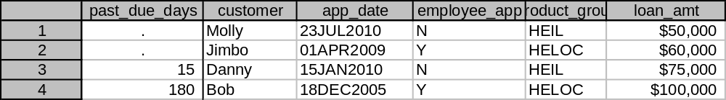
CHAPTER 5: Dataset Manipulation
Let’s give Danny and Bob their own Delinquencies.
We create a new dataset customer_past_due and use ‘IF THEN DO’ clauses.
data customer_past_due;
format past_due_days 5.0;
set loan_info_combine;
if customer=“Danny" then do;
past_due_days=15;
end;
if customer="Bob" then do;
past_due_days=180;
end;
run;
OUTPUT

Slide 39
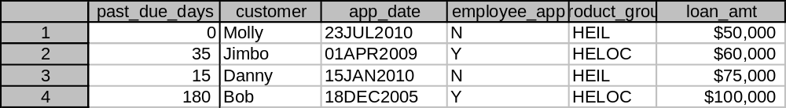
CHAPTER 5: Try on your own 1
Use this code but add the following
Past_due_days of 0 for Molly and 35 for Jimbo.
data customer_past_due;
format past_due_days 5.0;
set loan_info_combine;
if customer=“Danny" then do;
past_due_days=15;
end;
if customer="Bob" then do;
past_due_days=180;
end;
run;
OUTPUT

Slide 40
CHAPTER 5: Try on your own 1
(Solution)
data customer_past_due;
format past_due_days 5.0;
set loan_info_combine;
if customer="Molly" then do;
past_due_days=0;
end;
if upcase(customer)="JIMBO" then do;
past_due_days=35;
end;
if customer="Danny" then do;
past_due_days=15;
end;
if customer="Bob" then do;
past_due_days=180;
end;
run;

Slide 41
CHAPTER 5: Dataset Manipulation
Not only can you use the ‘IF THEN DO’ clause to add values to specific rows, you can ALSO choose which rows you want to keep in the dataset and which you want to leave out.

Slide 42
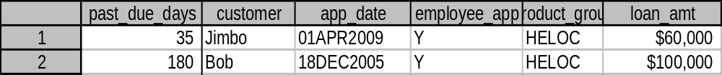
CHAPTER 5: Dataset Manipulation
Lets take the dataset ‘customer_past_due’ we just created and make a new dataset called ‘only_dq_loans’ with only 30+ past due loans.
Make the condition: if past_due_days >=30 is true, then output the row.
data only_dq_loans;
set customer_past_due;
if past_due_days >= 30 then do;
output;
end;
run;
OUTPUT ==>

Slide 43
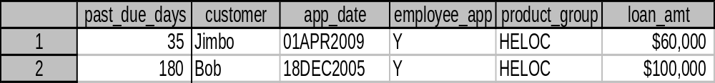
CHAPTER 5: Dataset Manipulation
Taking it further, lets create a dataset called employee_dq_loans’ from the ‘customer_past_due’ with employee accounts past due more than 0 days (past due at all).
data employee_dq_loans;
set customer_past_due;
if employee_app="Y" and past_due_days > 0 then do;
output;
end;
run;
OUTPUT ==>

Slide 44
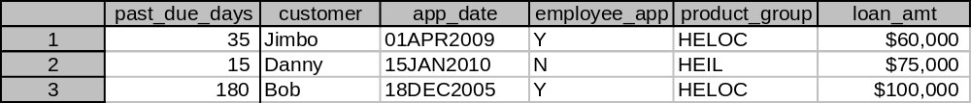
CHAPTER 5: Try on your own 2
Make a new dataset named ‘large_past_due’ from the ‘customer_past_due’ table with accounts that are 30+ past due OR have loans greater than $70,000.
data large_past_due;
set customer_past_due;
if ‘add statement’ ……..
run;
OUTPUT
Hint!: Remember ‘and’ in the condition statement ‘if employee_app="Y" and past_due_days > 0 then do;’ connected the two conditions? Do the same with ‘or’.

Slide 45
CHAPTER 5: Try on your own 2
(Solution)
data large_past_due;
set customer_past_due;
if past_due_days >= 30 or loan_amt >70000 then do;
output;
end;
run;

Slide 46
CHAPTER 6: Creating Libraries and
Storing Datasets
Day 4

Slide 47
CHAPTER 6: Creating Libraries and
Storing Datasets
Time to go get some data
We know how to get to our ‘Work’ library to find the datasets we’ve created so far.
Now it’s your turn to make your own library where you can permanently put your datasets you create and get them again when needed.

Slide 48
CHAPTER 6: Creating Libraries and
Storing Datasets
To tell SAS we want our own library we use a ‘libname’ (short for library name) statement.
This allows us to put data in a library/folder on your computer that stays after you close SAS, as opposed to the library called work that deletes your data after closing SAS.
Here we create a library called ‘customer’.
libname customer “d:\data\192465995\My Documents\SAS Training\DATA”;

Slide 49
CHAPTER 6: Try on your own 1
At the very TOP of your editor window write a libname statement creating a library called ‘customer’ and copy and paste the address to the folder on your computer that has the data I sent you last week.
libname customer “address to folder in here”;

Slide 50
CHAPTER 6: Creating Libraries and
Storing Datasets
So now you’ve created your own library.
To get data out we tell SAS there is a library with a dataset we want just like so.
data name;
set libname.datasetname ;
run;
Notice a period . separates the library name and dataset name.

Slide 51
CHAPTER 6: Try on Your Own 2
Lets go get one of those datasets we have stored in the newly created customer library.
Create a new dataset called als_loans_201104 from the dataset als201104 in your customer library.
data als_loans_201104;
set libname.datasetname ;
run;
Hint!:

Slide 52
CHAPTER 6: Try on Your Own 2
(Solution)
data als_loans_201104;
set customer.als201104;
run;

Slide 53
CHAPTER 6: Try on Your Own 3
Easy enough for the one dataset
Now, lets set all three of those datasets giving us 3 months of ALS accounts in a new dataset called ‘als_all’.
data als_all;
set libname.datasetname1
libname.datasetname2
libname.datasetname3 ;
run;
Hint!:

Slide 54
CHAPTER 6: Try on Your Own 3
(Solution)
data als_all;
set als201104
work.als201105
customer.als201106;
run;

Slide 55
CHAPTER 6: Try on Your Own 4
Right now you created a dataset called ‘als_all’ in your ‘work’ library.
Now instead store your new dataset in the ‘customer’ library so it will be there after you close SAS for future use in this class.
data libname.newdatasetname;
set libname.datasetname1
libname.datasetname2
libname.datasetname3;
run;
Hint!:

Slide 56
CHAPTER 6: Try on Your Own 4
(Solution)
data customer.als_all;
set customer.als201104
customer.als201105
customer.als201106;
run;

Slide 57
CHAPTER 7: Advanced Data Step
Day 5

Slide 58
CHAPTER 7: Advanced Data Step
Now you can get datasets from a custom made library and put datasets into a customized library.
Now we are going to elaborate on the functions of the DATA step

Slide 59
CHAPTER 7: Advanced Data Step
What is a function?
A function is like a premade program that allows you to put information into it and get certain information out of it.
  Example: I make a function called profit: Profit=revenue-cost
  So when I want to calculate profit I input 10 for Revenue and 6 for Cost.
    Profit(10, 6)=4

Slide 60
CHAPTER 7: Advanced Data Step
SAS already made many of these functions for you to speed up your work
Most Common:
  Put
  Input
  Substr
  Compress (Used for Appending)

Slide 61
CHAPTER 7: Advanced Data Step
Put function: Creates a character variable from a numeric variable
  New_variable=Put(old_variable, old variables format);
Input function: Creates a numeric variable from a character variable
  New_variable=input(old_variable, old variables format);
Substr function: Creates a new variable from a part of the old character’s value string.
  New_variable=substr(old_variable, starting position, # total characters);
Compress function: Creates a new variable by either removing all blanks or some other type of character. We will be using it to put to character variables together and removing spaces between them.
  New_Variable=compress(first variable ||second variable);

Slide 62
CHAPTER 7: Advanced Data Step
First we’ll turn a numeric date value into a character variable.
data als_character;
format date_char $10.;
set customer.als_all;
date_char=put(me_dt, date9.);
run;

Slide 63
CHAPTER 7: Try on you own 1
Create your own Dataset als_character.
Turn the numeric refresh_score variable into a character variable called score_char.
data als_character;
format score_char $4.;
set als_all;
score_char=put( , );
run;
Hint!

Slide 64
CHAPTER 7: Try on you own 1
(Solution)
data als_character;
format score_char $4.;
set customer.als_all;
score_char=put(refresh_score, 4.0);
run;

Slide 65
CHAPTER 7: Try on your own 2
Now use your als_character to create a new dataset called als_numeric.
Next change the new character variable score_num back into a numeric variable called score_num.
data als_numeric;
format score_num 4.0;
set als_character;
score_num= ;
run;
Hint!

Slide 66
CHAPTER 7: Try on your own 2
(Solution)
data als_numeric;
format score_num 4.0;
set als_character;
score_num=input(score_char, $4.);
run;

Slide 67
CHAPTER 7: Advanced Data Step
Now lets create a new variable out of a substring from the first 3 characters of another variable.
We create a new dataset called als_substr from the als_numeric dataset.
data als_substr;
format acct_substr $3.;
set als_numeric;
acct_substr=substr(acct_umk, 1, 3);
run;

Slide 68
CHAPTER 7: Try on your own 3
Create your own dataset als_substr_end from the dataset als_substr.
Create a new variable acct_substr_end that is from the character string acct_umk that includes ALL of the characters starting from the 4 position and going to the end.
  A182348573 ➔ 2348573
data als_substr_end;
format acct_substr_end $11.;
set als_substr;
acct_substr_end= ;
run;
Hint!
Hint!
acct_substr=substr(acct_umk, 1, 3);

Slide 69
CHAPTER 7: Try on your own 3
(Solution)
data als_substr_end;
format acct_substr_end $11.;
set als_substr;
acct_substr_end=substr(acct_umk, 4, 11);
run;

Slide 70
CHAPTER 7: Advanced Data Step
Finally lets use the compress to put the two parts of the acct_umk back together.
data als_substr_compress;
format acct_substr_compress $15.;
set als_substr_end;
acct_substr_compress = compress(acct_substr||acct_substr_end);
run;

Slide 72
CHAPTER 7: Advanced Data Step
Day 6

Slide 73
CHAPTER 7: Advanced Data Step
FRIDAY!!!!!!!!
If you made it in today we are going to learn one of the greatest and useful yet unused tricks in a DATA step…and one of the most unknown by beginners.

Slide 74
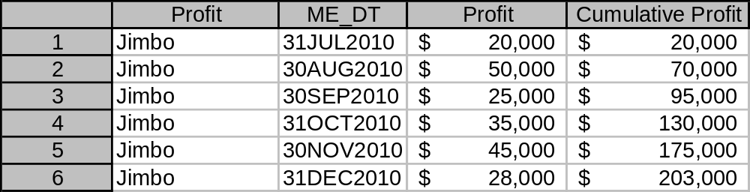
CHAPTER 7: Advanced Data Step
The MIGHTY RETAIN statement!
  Allows you to cumulate in a dataset by ‘retaining’ the value, in this case Profit, from a previous row.

Slide 75
CHAPTER 7: Try on your own 1
First lets create our sample dataset by creating a new dataset called als_subset from your als_all dataset and select only loan “A8118100004814”
data als_subset;
set customer.als_all;
if .... then do;
.......;
end;
run;
Hint!

Slide 76
CHAPTER 7: Try on your own 1
(Solution)
data als_subset;
set customer.als_all;
if acct_umk="A8118100004814" then do;
output;
end;
run;

Slide 77
CHAPTER 7: Advanced Data Step
Now we have our data lets learn what the Retain function looks like.
data dataset_name;
format new_var w.d;
set old_data;
retain new_var 0; /*Retains the previous rows value of new_var and sets the
initial value to 0 */
new_var=new_var + (variable you are cumulating);
run;

Slide 78
CHAPTER 7: Try on your own 2
Now do your own with the dataset als_subset you just created.
  New dataset name: als_cumulate
  New Variable: Cum_balance, set to 0 initially
  Variable you are cumulating: me_balance
Hint!
data dataset_name;
format new_var w.d;
set old_data;
retain new_var 0; /*Retains the previous rows value of new_var and sets the initial value
to 0 */
new_var=new_var + (variable you are cumulating);
run;

Slide 79
CHAPTER 7: Try on your own 2
(Solution)
data als_cumulate;
format cum_balance dollar10.0;
set als_subset;
retain Cum_balance 0;
Cum_balance=Cum_balance + me_balance;
run;

Slide 80
CHAPTER 7: Try on your own 2
(Extension)
proc sort data= customer.als_all;
by acct_umk me_dt;
run;
data als_cumulate2;
format cum_balance dollar10.0;
set customer.als_all;
by acct_umk;
if first.acct_umk=1 then do;
cum_balance = me_balance;
end;
else do;
retain cum_balance;
cum_balance=cum_balance + me_balance;
end;
run;

Slide 81
CHAPTER 8: Proc SQL
Day 7

Slide 82
CHAPTER 8: Proc SQL
Up to now we’ve focused on the DATA step.
Now we’re going to move on to PROC steps starting with PROC SQL.

Slide 83
CHAPTER 8: Proc SQL
PROC SQL allows you to:
  Create a new data set from a previous dataset like you did when using the SET statement in the DATA step
  Choose which columns you want in the new dataset
  Merge data ‘sideways’ rather than just appending one dataset on top of another
  Group data
  Order data
  Format data
  Label data
  Take sums, averages, minimums, maximums, etc...
  AAAAND use all the functions you can use in the DATA step (input, put, substr, compress, etc…)

Slide 84
CHAPTER 8: Proc SQL
PROC SQL statement:
proc sql; /* Tells SAS you’re going to START using SQL method */
create table libname.newtable as /* Names your new dataset */
select column1, column2, column3 /* notice commas b/w columns */
from libname.old_data_set
order by column1; /* notice a semicolon is used ONLY after finish designing table */
quit; /* Tells SAS you’re FINISHED using SQL method */

Slide 85
CHAPTER 8: Try on your own 1
Create a new table in your ‘customer’ library called ‘als_SQL.APR’ from your als201104 table that’s in your customer library.
Choose columns: me_dt, acct_umk, me_balance, past_due_days
Order by acct_umk
HINT!
proc sql; /* Tells SAS you’re going to START using SQL method */
create table libname.newtable as /* Names your new dataset */
select column1, column2, column3 /* notice commas b/w columns */
from libname.old_data_set
order by column1; /* notice a semicolon is used ONLY after finish designing table */
quit; /* Tells SAS you’re FINISHED using SQL method */

Slide 86
CHAPTER 8: Try on your own 1
(Solution)
proc sql;
create table customer.als_SQL_april as
select me_dt, acct_umk, me_balance, past_due_days
from customer.als201104
order by acct_umk;
quit;

Slide 87
CHAPTER 8: Proc SQL
PROC SQL also allows you to change the names of the variables the following way:
  Rename me_balance to APR_Balance
  Rename past_due_days to APR_Past_Due
proc sql;
create table customer.als_SQL_april as
select me_dt, acct_umk, me_balance as APR_Balance, past_due_days as APR_Past_Due
from customer.als201104
order by acct_umk;
quit;

Slide 88
CHAPTER 8: Proc SQL
Wait, the dataset variables didn’t change!
But they did, just not their ‘Labels’
Lets change the labels and add formatting like in the DATA step!
proc sql;
create table customer.als_SQL_april as
select me_dt, acct_umk, me_balance as APR_Balance label="APR_Balance" format dollar12.0,
past_due_days as APR_Past_Due label="APR_Past_Due"
from customer.als201104
order by acct_umk;
quit;

Slide 89
CHAPTER 8: Try on your own 2
Create another dataset in your ‘customer’ library called ‘als_SQL_may’ from your als201105 dataset
Use the same variables as the other dataset (me_dt, acct_umk etc…) and label and format appropriately (APR_Past_Due is now MAY_Past_Due, etc…)
HINT!
proc sql;
create table customer.als_SQL_april as
select me_dt, acct_umk, me_balance as APR_Balance label="APR Balance" format dollar12.0,
past_due_days as APR_Past_Due label="APR Past Due"
from customer.als201104
order by acct_umk;
quit;

Slide 90
CHAPTER 8: Try on your own 2
(Solution)
proc sql;
create table als_SQL_may as
select me_dt, acct_umk, me_balance as MAY_Balance label="MAY_Balance" format dollar12.0,
past_due_days as MAY_Past_Due label="MAY_Past_Due"
from customer.als201105
order by acct_umk;
quit;

Slide 91
CHAPTER 8: Proc SQL
Joining/Merging datasets!
First we need to understand the idea of merging (which from now on we call JOINING) datasets.

Slide 92
CHAPTER 8: Proc SQL
Visual Interpretation of join
In Both L
and
R
ONLY In Dataset L
ONLY In Dataset R

Slide 93
CHAPTER 8: Proc SQL
Example: Two classes Math and Reading
Dataset M is students in Math
Dataset R is students in Reading class
R
M
Adam
Daisy
Bubba
Smith
Jimbo
Ally
Nick
Jason
Amy
Samantha
Jimbo
Ally

Slide 94
CHAPTER 8: Proc SQL
Joining the Datasets together we get this
  Nick, Jason, Amy Samantha are ONLY in the Math class
  Adam, Daisy, Bubba, Smith are ONLY in the Reading class
  Jimbo and Ally are in BOTH the Reading Class AND the Math Class
R
M
Nick
Jason
Amy
Samantha
Adam
Daisy
Bubba
Smith
Both
Jimbo
Ally

Slide 95
CHAPTER 8: Proc SQL
When we join we need to explain what information we want from each Class
  Do we want class information from:
  ONLY students in Math (left join), Only those in Reading (right join), or Only those in Both (inner join)
R
M
Nick
Jason
Amy
Samantha
Adam
Daisy
Bubba
Smith
Both
Jimbo
Ally

Slide 96
CHAPTER 8: Proc SQL
Day 8

Slide 97
CHAPTER 8: Proc SQL
Joining datasets!
Now to learn how to JOIN datasets to get the information we need from them

Slide 98
CHAPTER 8: Proc SQL
The Syntax of Joining
proc sql;
create table new_table as
select l.column1, l.column2, r.column1
from left_table as l left join right_table as r
on l.joining_column = r. joining_column;
quit;

Slide 99
CHAPTER 8: Proc SQL
Example
proc sql;
create table als_APR_MAY as
select l.acct_umk, l.APR_Balance, r.MAY_Balance
from customer.als_sql_april as l left join customer.als_sql_may as r
on l.acct_umk=r.acct_umk;
quit;

Slide 100
CHAPTER 8: Try on your own 1
Now try repeating the previous example but add dollar formatting to the APR_Balance and MAY_Balance
HINT!
proc sql;
create table als_APR_MAY as
select l.acct_umk, l.APR_Balance, r.MAY_Balance
from customer.als_sql_april as l left join customer.als_sql_may as r
on l.acct_umk=r.acct_umk;
quit;

Slide 101
CHAPTER 8: Try on your own 1
(Solution)
proc sql;
create table als_APR_MAY as
select l.acct_umk,
l.APR_Balance format dollar15.0,
r.MAY_Balance format dollar15.0
from customer.als_sql_april as l left join customer.als_sql_may as r
on l.acct_umk=r.acct_umk;
quit;

Slide 102
CHAPTER 8: Try on your own 2
Now try repeating the previous example AGAIN but add the Past due days from each dataset
HINT!
proc sql;
create table als_APR_MAY as
select l.acct_umk,
l.APR_Balance format dollar15.0,
r.MAY_Balance format dollar15.0
from customer.als_sql_april as l left join customer.als_sql_may as r
on l.acct_umk=r.acct_umk;
quit;

Slide 103
CHAPTER 8: Try on your own 2
(Solution)
proc sql;
create table als_APR_MAY as
select l.acct_umk,
l.APR_Balance format dollar15.0,
r.MAY_Balance format dollar15.0,
l.APR_past_due,
r.MAY_Past_Due
from customer.als_sql_apr as l left join customer.als_sql_may as r
on l.acct_umk=r.acct_umk;
quit;

Slide 104
CHAPTER 8: Proc SQL
Now we’ll Group our information!
Lets group the APR_Balance and MAY_Balance to see the difference
proc sql;
create table als_APR_MAY_Sum as
select sum(l.APR_Balance) as APR_BALANCE format dollar15.0,
sum(r.MAY_Balance) as MAY_Balance format dollar15.0
from customer.als_sql_april as l left join customer.als_sql_may as r
on l.acct_umk=r.acct_umk;
quit;

Slide 105
CHAPTER 8: Try on your own 3
Now we’ll Group our information!
Instead of SUMming it we’ll take the Average for each month
  Create a NEW Dataset called ALS_APR_MAY_AVE
  Replace SUM with MEAN
HINT!
proc sql;
create table als_APR_MAY_Sum as
select sum(l.APR_Balance) as APR_BALANCE format dollar15.0,
sum(r.MAY_Balance) as MAY_Balance format dollar15.0
from customer.als_sql_april as l left join customer.als_sql_may as r
on l.acct_umk=r.acct_umk;
quit;

Slide 106
CHAPTER 8: Try on your own 3
(Solution)
proc sql;
create table als_APR_MAY_Ave as
select mean(l.APR_Balance) as APR_BALANCE format dollar15.0,
mean(r.MAY_Balance) as MAY_Balance format dollar15.0
from customer.als_sql_april as l left join customer.als_sql_may as r
on l.acct_umk=r.acct_umk;
quit;

Slide 107
CHAPTER 8: Proc SQL
Now lets subset the MAY table keeping only accounts past due more than 30 days
proc sql;
create table als_MAY_DQ as
select *
from customer.als_sql_may
where may_past_due >=30;
quit;

Slide 108
CHAPTER 8: Proc SQL
We’ll now use the new DQ table to INNER JOIN with the customer.als_sql_april table giving us only the accounts that will be 30 days past due in May
proc sql;
create table als_APR_MAY_DQ as
select l.acct_umk,
l.APR_Balance format dollar15.0,
r.MAY_Balance format dollar15.0,
l.APR_past_due,
r.MAY_Past_Due
from customer.als_sql_april as l inner join als_may_DQ as r
on l.acct_umk = r.acct_umk;
quit;

Slide 109
CHAPTER 8: Proc SQL
Common Grouping Functions in SQL
  MEAN ‘MEAN/AVERAGE OF VALUES’
  SUM ‘SUM OF VALUES’
  COUNT ‘NUMBER NONMISSING VALUES’
  NMISS ‘NUMBER MISSING VALUES’
  MAX ‘MAXIMUM VALUE OF COLUMN IN GROUP’
  MIN ‘MINIMUM VALUE OF COLUMN IN GROUP’
  STD ‘STANDARD DEVIATION’

Slide 110
CHAPTER 8: Proc SQL
Day 9

Slide 111
CHAPTER 8: Proc SQL
Last class you learned how to JOIN tables to get the columns needed out of each and then how to group the data with summary statistics (sum, mean, etc…)
Now we’ll go over how to use conditional statements in Proc SQL to create new variables and to create sub-queries (sounds harder than it is)

Slide 112
CHAPTER 8: Proc SQL
Conditional statements in Proc SQL
  Where ‘you learned this last class’
  CASE ‘allows you to create new variables in New ways creating immense room for creativity’

Slide 113
CHAPTER 8: Proc SQL
First we’ll recap the ‘WHERE’ statement
The code below created a table with May accounts over 30 days past due to INNER join with April account information.
The END GOAL was to understand what April accounts would be 30+ late in May
  ALWAYS keep the end goal in mind, It will save you a lot of energy by not writing more code than you need to
proc sql;
create table als_MAY_DQ as
select *
from customer.als_sql_may
where may_past_due >=30;
quit;

Slide 114
CHAPTER 8: Proc SQL
So how could we have found the April accounts that will be 30+ late in May without joining them together and checking?
THATS RIGHT!!! The SUB-QUERY!
proc sql;
create table als_APR_DQ_in_MAY as
select *
from customer.als_sql_April
where acct_umk in(select distinct acct_umk
from customer.als_sql_May
where May_past_due>=30);
quit;

Slide 115
CHAPTER 8: Try on your own 1
YOUR TURN! *<:^D
  Create a table called als_APR_HighBal_May from your als_sql_april table that contains all the accounts that will have balances greater than $40,000
  Hint!: Like the example below, your criteria is based on May’s data so you put it in the SUB-Query
HINT!
proc sql;
create table als_APR_DQ_in_MAY as
select *
from customer.als_sql_April
where acct_umk in(select distinct acct_umk
from customer.als_sql_May
where May_past_due>=30);
quit;

Slide 116
CHAPTER 8: Try on your own 1
(Solution)
proc sql;
create table als_APR_HighBal_MAY as
select *
from customer.als_sql_April
where acct_umk in(select distinct acct_umk
from customer.als_sql_May
where May_balance>40000);
quit;

Slide 117
CHAPTER 8: Try on your own 2
YOUR TURN AGAIN! *<:^D
  Use the table code you just created to create a new table ‘als_DQ_APR_HighBal_MAY’ and now add an ADDITIONAL criteria to be included in your new table.
  You Only want the accounts with balances > $40,000 in May that are ALSO 30+ late in APRIL
  Hint!: Your May loans >40,000 is based on May data but your 30+ late is based on April data….so the 30+ condition on April’s data should NOT be INSIDE the SUB-QUERY.
HINT!
proc sql;
create table als_APR_HighBal_MAY as
select *
from customer.als_sql_April
where acct_umk in(select distinct acct_umk
from customer.als_sql_May
where May_balance>40000);
quit;

Slide 118
CHAPTER 8: Try on your own 2
(Solution)
proc sql;
create table als_DQ_APR_HighBal_MAY as
select *
from customer.als_sql_April
where acct_umk in(select distinct acct_umk
from customer.als_sql_May
where May_balance>40000)
and APR_past_due>=30;
quit;

Slide 119
CHAPTER 8: Try on your own 2
(Solution Alternative)
Or you could have done a SUB-Query IN your SUB-QUERY!
proc sql;
create table als_DQ_APR_HighBal_MAY_Alt as
select *
from customer.als_sql_April
where acct_umk in(select distinct acct_umk
from customer.als_sql_May
where May_balance>40000
and acct_umk in(select distinct acct_umk
from customer.als_sql_april
where APR_past_due>=30));
quit;

Slide 120
CHAPTER 8: Proc SQL
Moving ON to the CASE statement
If you remember earlier classes using the DATA Step we used the IF THEN DO to say if a Condition was met we wanted SAS to do something special (output the row, retain the value, etc…)
A similar idea is used in Proc SQL to tell SAS what to do when conditions are met.
CASE statement
proc sql;
create table New_table as
select *,
CASE
when condition1 is true then "Value1"
when condition2 is true then "Value2"
END as New_Variable
from old table;
quit;

Slide 121
CHAPTER 8: Proc SQL
EXAMPLE
We’ll create a table from our als_DQ_APR_HighBal_MAY called ALS_DQ_Buckets and create a new variable for if an account is 30-59 days late, 60-89, or 90+
proc sql;
create table ALS_DQ_Buckets as
select *,
CASE
when 30<=APR_past_due<=59 then "30-59"
when 60<=APR_past_due<=89 then "60-89"
when APR_past_due>=90 then "90+"
END as Past_Due_Bucket
from als_DQ_APR_HighBal_MAY;
quit;

Slide 122
CHAPTER 8: Try on your own
Now create your own table: ALS_April_DQ_Buckets from your dataset als_SQL_April in the Customer folder and create buckets for 0-29, 30-59, 60-89, 90-119, and 120+ days late.
proc sql;
create table ALS_April_DQ_Buckets as
select *,
CASE
when then
when then
when then
when then
when then
END as Past_Due_Bucket
from customer.als_SQL_April;
quit;

Slide 123
CHAPTER 8: Try on your own
(Solution)
proc sql;
create table ALS_April_DQ_Buckets as
select *,
CASE
when 0<=APR_past_due<=29 then "0-29"
when 30<=APR_past_due<=59 then "30-59"
when 60<=APR_past_due<=89 then "60-89"
when 90<=APR_past_due<=119 then "90-120"
when APR_past_due>=120 then "120+"
END as Past_Due_Bucket
from customer.als_SQL_April;
quit;

Slide 124
CHAPTER 9: MACRO Variables
Day 10

Slide 125
CHAPTER 9: MACRO Variables
Now you know how to write a decent amount of code.
Say you wrote the familiar looking code below:
proc sql;
create table als_DQ_APR_HighBal_MAY as
select *
from customer.als_sql_April
where acct_umk in(select distinct acct_umk
from customer.als_sql_May
where May_balance>40000)
and APR_past_due>=30;
quit;

Slide 126
CHAPTER 9: MACRO Variables
What if you didn’t want to choose accounts with May_balance>40000?
What if you have several (possibly hundreds) different Queries all using the 40000 amount and decide you need to change it to May_balance > 60000?
  Too Bad! Guess you better go through your ugly code and hope you change everything correctly or risk getting the wrong results even when your code works fine!
proc sql;
create table als_DQ_APR_HighBal_MAY as
select *
from customer.als_sql_April
where acct_umk in(select distinct acct_umk
from customer.als_sql_May
where May_balance>40000)
and APR_past_due>=30;
quit;

Slide 127
CHAPTER 9: MACRO Variables
An Alternative? Try creating a Macro variable that you only change the value of once and it updates the rest of your code FOR YOU.
Sound great and time saving? IT IS! *<:^D
%let balance=40000; /* Creates a Macro Variable called ‘balance’ and you set it to 40000 */
/* tell SAS to use Macro variable ‘balance’ by putting a ‘&’ in front of the variable name */
proc sql;
create table als_DQ_APR_HighBal_MAY as
select *
from customer.als_sql_April
where acct_umk in(select distinct acct_umk
from customer.als_sql_May
where may_balance > &balance. )
and APR_past_due>=30;
quit;
notice the ‘&’ in front of balance
And the ‘.’ period at the end

Slide 128
CHAPTER 9: MACRO Variables
Now we want to change the size of may_balances criteria we want throughout our code to >60000.
Just change the Macro Variable!
%let balance=60000; /* Changes the value to 60000 which will be updated throughout your code */
proc sql;
create table als_DQ_APR_HighBal_MAY as
select *
from customer.als_sql_April
where acct_umk in(select distinct acct_umk
from customer.als_sql_May
where may_balance > &balance. )
and APR_past_due>=30;
quit;
⬅ &balance. will now be 60000

Slide 129
CHAPTER 9: Try on your own 1
Now add a new Macro variable called past_due, set = 30, for the APR_past_due variable that will let you easily change it from now on.
HINT!
%let balance=60000;
proc sql;
create table als_DQ_APR_HighBal_MAY as
select *
from customer.als_sql_April
where acct_umk in(select distinct acct_umk
from customer.als_sql_May
where may_balance > &balance. )
and APR_past_due>=30;
quit;

Slide 130
CHAPTER 9: Try on your own 1
(Solution)
%let balance=60000;
%let past_due=30;
proc sql;
create table als_DQ_APR_HighBal_MAY as
select *
from customer.als_sql_April
where acct_umk in(select distinct acct_umk
from customer.als_sql_May
where may_balance > &balance. )
and APR_past_due>= &past_due. ;
quit;

Slide 131
CHAPTER 9: Try on your own 2
Now create a Macro variable called ‘month’ ,set = May, for which month, April or May, you want the Sub-Query information from.
HINT!: The Macro variable goes into the table name: Customer.als_sql_May where it says ‘May’
%let balance=60000;
%let past_due=30;
proc sql;
create table als_DQ_APR_HighBal_MAY as
select *
from customer.als_sql_April
where acct_umk in(select distinct acct_umk
from customer.als_sql_May
where may_balance > &balance. )
and APR_past_due>= &past_due. ;
quit;

Slide 132
CHAPTER 9: Try on your own 2
(Solution)
%let balance=60000;
%let past_due=30;
%let Month=May;
proc sql;
create table als_DQ_APR_HighBal_MAY as
select *
from customer.als_sql_April
where acct_umk in(select distinct acct_umk
from customer.als_sql_&month.
where may_balance>&balance.)
and APR_past_due>=&past_due.;
quit;

Slide 133
CHAPTER 9: Try on your own 3
Now tell SAS to create the dataset using the following:
  APR_Past_Due >= 1
  May_balance > 75000
HINT!: You only have to change the values of the macro variables.
%let balance=60000;
%let past_due=30;
%let Month=May;
proc sql;
create table als_DQ_APR_HighBal_MAY as
select *
from customer.als_sql_April
where acct_umk in(select distinct acct_umk
from customer.als_sql_&month.
where may_balance>&balance.)
and APR_past_due>=&past_due.;
quit;

Slide 134
CHAPTER 9: Try on your own 3
(Solution)
%let balance=75000;
%let past_due=1;
%let Month=May;
proc sql;
create table als_DQ_APR_HighBal_MAY as
select *
from customer.als_sql_April
where acct_umk in(select distinct acct_umk
from customer.als_sql_&month.
where may_balance>&balance.)
and APR_past_due>=&past_due.;
quit;

Slide 135
CHAPTER 9: Extra 1
Now we want to create a macro variable filled with our acct_umks that satisfy our criteria.
%let acct_high_pd=;
proc sql;
select acct_umk into :acct_high_pd separated by " "
from customer.als_sql_April
where apr_past_due>=90;
quit;
%put &acct_high_pd. ;

Slide 136
CHAPTER 9: Extra 2
Now we want to create a macro variable filled with today’s Date so we can use it throughout our code.
data date;
format current date9.;
current=today();
current_date = put(current,date9.);
run;
%let current_date=;
proc sql;
select current_date into :current_date
from date;
quit;
%put &current_date. ;

Slide 137
CHAPTER 10: MACROS!
Day 11

Slide 138
CHAPTER 10: MACROS
Since you can now create Macro Variables with no trouble we’ll move on to how to make a Macro to automate your own program.
%macro dq_table(macro_var1=, macro_var2=,etc…);
Lines of Code….
%mend dq_table;

Slide 139
CHAPTER 10: MACROS
So let’s automate our program.
But before we get to that point we need to write a program.
This gives us a great chance to review some of the material we’ve learned in the class so far.

Slide 140
CHAPTER 10: MACROS
So the goal of this exercise is to create a program that will create a table showing changes in DQ balances over the course of three months.
We will be able to choose how many days late count as Delinquent (30+, 60+, 90+, etc…)
We will get a new table each time based on what we call a delinquent account.

Slide 141
CHAPTER 10: MACROS
Lets go through this step by step.
First lets create our als tables with DQ balances.
We’ll start out by considering accounts 30+ past due as Delinquent.
data als201104;
format DQ_Balance dollar15.0;
set customer.als201104;
if past_due_days >30 then do;
DQ_Balance = me_balance;
end;
else do;
DQ_Balance = 0;
end;
run;

Slide 142
CHAPTER 10: Try on your own 1
Now do the same for the als201105 and 201106 tables in your customer library.
data als201104;
format DQ_Balance dollar15.0;
set customer.als201104;
if past_due_days >30 then do;
DQ_Balance = me_balance;
end;
else do;
DQ_Balance = 0;
end;
run;

Slide 143
CHAPTER 10: Try on your own 2
Now take those 3 tables and use a Data Step to combine them using the set statement.
New table ALS_ALL_DQ

Slide 144
CHAPTER 10: Try on your own 2
(Solution)
data als_all_DQ;
set als201104
als201105
als201106;
run;

Slide 145
CHAPTER 10: Try on your own 3
Now create a new table: als_all_dq_change using proc sql.
We want 4 columns:
  Me_dt
  Sum of me_balance format dollar20.0
  Sum of dq_balance format dollar20.0
  percent of me_balance that is delinquent: sum(dq_balance)/sum(me_balance) format percent8.2
Group by the me_dt because we want the monthly totals.

Slide 146
CHAPTER 10: Try on your own 3
(Solution)
proc sql;
create table als_all_dq_change as
select distinct me_dt,
sum(me_balance) as me_balance format dollar20.0,
sum(DQ_Balance) as dq_balance format dollar20.0,
sum(me_balance)/sum(DQ_Balance) as pct_DQ format percent8.2
from als_all_dq
group by me_dt;
quit;

Slide 147
CHAPTER 10: Try on your own 4
Now create a macro variable for how many past due days you want to use to classify an account delinquent.
Insert the new macro variable into your code.
Also insert the macro variable at the very end of the final output table➔ als_all_dq_change_&past_due.

Slide 148
CHAPTER 10: Try on your own 4
(Solution)
%let past_due = 30;
data als201104;
format DQ_Balance dollar15.0;
set customer.als201104;
if past_due_days>&past_due. then do;
DQ_Balance=me_balance;
end;
else do;
DQ_Balance=0;
end;
run;
………………………………….
………………………………….
proc sql;
create table als_all_dq_change_&past_due. as
select distinct me_dt,
sum(me_balance) as me_balance format dollar20.0,
sum(DQ_Balance) as dq_balance format dollar20.0,
sum(DQ_Balance)/sum(me_balance) as pct_DQ format percent8.2
from als_all_dq
group by me_dt;
quit;

Slide 149
CHAPTER 10: MACROS
Now to change it into a Macro! named dq_table.
Remember the syntax for a macro below:
%macro dq_table(pastdue=);
Lines of Code….
%mend dq_table;

Slide 150
CHAPTER 10: MACROS
%macro dq_table (past_due=);
data als201104;
format DQ_Balance dollar15.0;
set customer.als201104;
if past_due_days>&past_due. then do;
DQ_Balance=me_balance;
end;
else do;
DQ_Balance=0;
end;
run;
………………………………….
………………………………….
proc sql;
create table als_all_dq_change_&past_due. as
select distinct me_dt,
sum(me_balance) as me_balance format dollar20.0,
sum(DQ_Balance) as dq_balance format dollar20.0,
sum(DQ_Balance)/sum(me_balance) as pct_DQ format percent8.2
from als_all_dq
group by me_dt;
quit;
%mend dq_table;

Slide 151
CHAPTER 10: MACROS
Now to USE/CALL the macro and tell it to use past due days of 30+ to assign an account as delinquent and create a table with the monthly delinquency changes.
%dq_table(past_due=30);
CONGRATULATIONS!

Slide 152
CHAPTER 11: EXCEL Add-In
Day 12

Slide 153
CHAPTER 11: EXCEL Add-In
You can use SAS Data Steps, Proc SQL, and Macros! Can life get ANY Better?
YES! We can take our data and stick it in Excel for easy Reporting!
We now Optimize on both programs strengths, SAS’s data manipulation and Excel’s easy visuals!

Slide 154
CHAPTER 11: EXCEL Add-In
Step one!
  Get your data into a suitable form i.e. with the variables you want in your report and summed or averaged the way you want
Step two!
  Decide if you want to put the data in an Excel Pivot Table for further manipulations or, if it is ready to look at and make graphs out of, put the data directly into Excel EXACTLY as it looks in your SAS dataset

Slide 155
CHAPTER 11: EXCEL Add-In
Why go through this?
By putting the information into Excel we can update our Excel tables and pivots (rerun our code month to month if need be) just by running your SAS code with the new months data that is now linked to the excel tables and pivots.

Slide 156
CHAPTER 11: EXCEL Add-In
So lets take our macro we created last time but:
  Remove the macro variable that is in the name of our final output table.
  Add the customer libname to the table you create so it stores in that folder on your computer.
Remove
proc sql;
create table customer.als_all_dq_change_&past_due. as
select distinct me_dt,
sum(me_balance) as me_balance format dollar20.0,
sum(DQ_Balance) as dq_balance format dollar20.0,
sum(DQ_Balance)/sum(me_balance) as pct_DQ format percent8.2
from als_all_dq
group by me_dt;
quit;

Slide 157
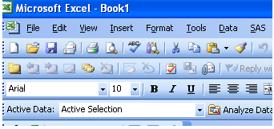
CHAPTER 11: EXCEL Add-In
Now we are going to take this dataset and put the whole thing into an Excel sheet.
Hopefully you successfully added the SAS Add-In and you should see this:

Slide 158
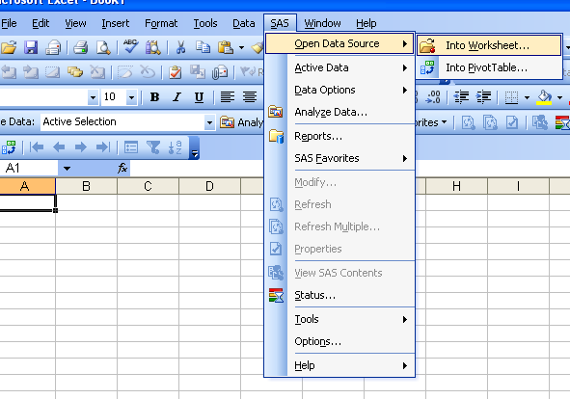
CHAPTER 11: EXCEL Add-In
Select SAS ➔ Open Data Source ➔ Into Worksheet

Slide 159
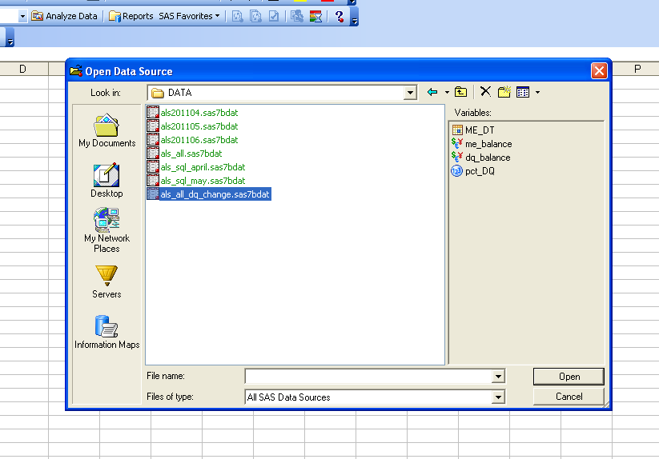
CHAPTER 11: EXCEL Add-In
Navigate to your file in your customer library folder

Slide 160
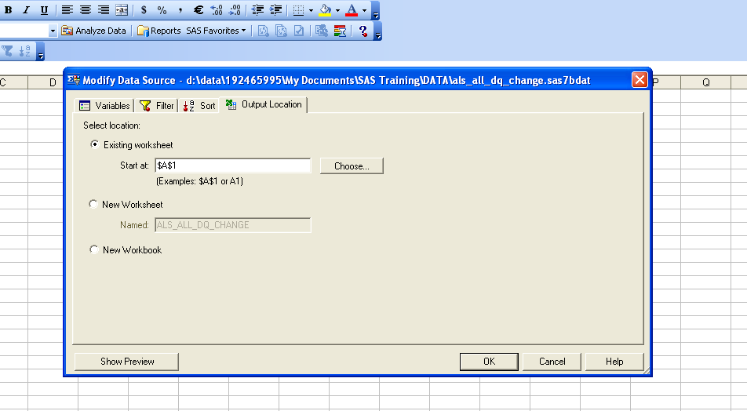
CHAPTER 11: EXCEL Add-In
Select your variables and go to the OUTPUT Location tab and choose existing worksheet
Click okay

Slide 161
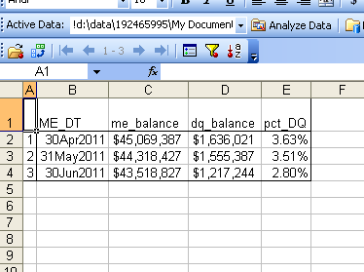
CHAPTER 11: EXCEL Add-In
And there you have it!

Slide 162
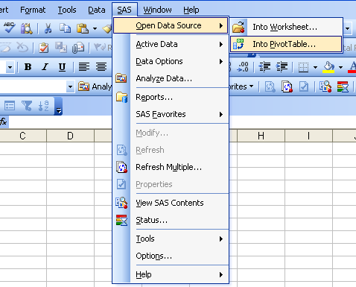
CHAPTER 11: EXCEL Add-In
Now lets create a pivot table from SAS!
SAS ➔ Open Data Source ➔ Into PivotTable

Slide 163
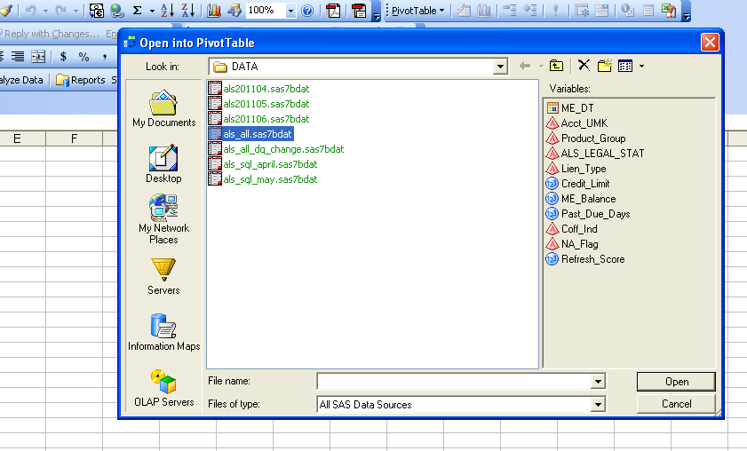
CHAPTER 11: EXCEL Add-In
Choose you ALS_All table in your customer folder.

Slide 164
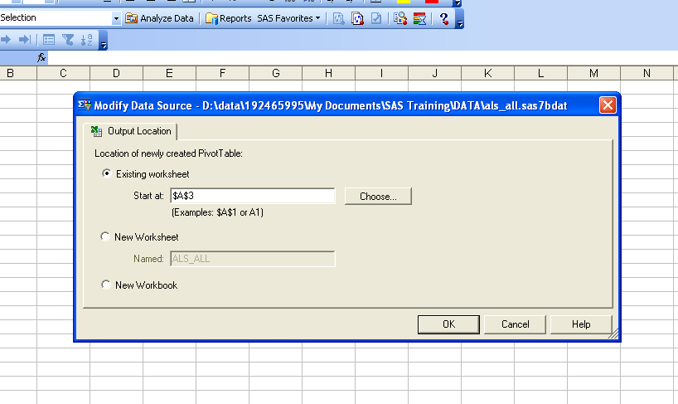
CHAPTER 11: EXCEL Add-In
Choose Existing worksheet
Click OK

Slide 165
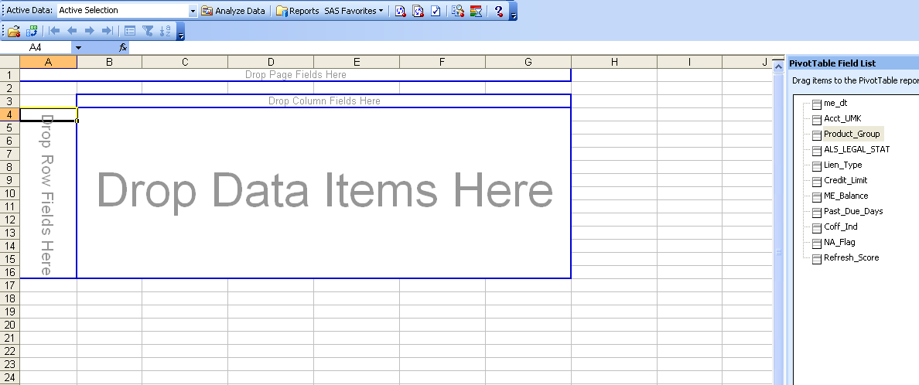
CHAPTER 11: EXCEL Add-In
And there you have it!

Slide 166
SAS ALL STARS!!!!!!!
CONGRATULATIONS!!!!!!!!!!!!!!!

